Slide 1

Design a Sequence Detector
ECE 2372 | Modern Digital System Design | Texas Tech University

Slide 2

Lecture Overview
Design Specification
State Graph
State Table
Transition Table
Next-State and Output Equations
Verilog Implementation

Slide 3

Design Specification
Design a Sequence Detector
Modern Digital System Design

Slide 4
Design Specification
The circuit will examine a string of 0’s and 1’s applied to the X input and generate an output Z = 1 only when a prescribed input sequence Occurs.
X
Z
CLK

Slide 5

Design Specification
We will design the sequence detector to output a 1 anytime the input sequence is $X=\{1, 0, 1\}$

Slide 6
Design Specification
TIME | 0 | 1 | 2 | 3 | 4 | 5 | 6 | 7 | 8 | 9 | 10 | 11 | 12 | 13 | 14
X =
Z =

Slide 7
Design Specification
TIME | 0 | 1 | 2 | 3 | 4 | 5 | 6 | 7 | 8 | 9 | 10 | 11 | 12 | 13 | 14
X = | 0
Z =

Slide 8
Design Specification
TIME | 0 | 1 | 2 | 3 | 4 | 5 | 6 | 7 | 8 | 9 | 10 | 11 | 12 | 13 | 14
X = | 0 | 0
Z = | 0

Slide 9
Design Specification
TIME | 0 | 1 | 2 | 3 | 4 | 5 | 6 | 7 | 8 | 9 | 10 | 11 | 12 | 13 | 14
X = | 0 | 0 | 1
Z = | 0 | 0

Slide 10
Design Specification
TIME | 0 | 1 | 2 | 3 | 4 | 5 | 6 | 7 | 8 | 9 | 10 | 11 | 12 | 13 | 14
X = | 0 | 0 | 1 | 0
Z = | 0 | 0 | 0

Slide 11
Design Specification
TIME | 0 | 1 | 2 | 3 | 4 | 5 | 6 | 7 | 8 | 9 | 10 | 11 | 12 | 13 | 14
X = | 0 | 0 | 1 | 0 | 1
Z = | 0 | 0 | 0 | 0

Slide 12
Design Specification
TIME | 0 | 1 | 2 | 3 | 4 | 5 | 6 | 7 | 8 | 9 | 10 | 11 | 12 | 13 | 14
X = | 0 | 0 | 1 | 0 | 1 | 1
Z = | 0 | 0 | 0 | 0 | 1

Slide 13
Design Specification
TIME | 0 | 1 | 2 | 3 | 4 | 5 | 6 | 7 | 8 | 9 | 10 | 11 | 12 | 13 | 14
X = | 0 | 0 | 1 | 0 | 1 | 1 | 0
Z = | 0 | 0 | 0 | 0 | 1 | 0

Slide 14
Design Specification
TIME | 0 | 1 | 2 | 3 | 4 | 5 | 6 | 7 | 8 | 9 | 10 | 11 | 12 | 13 | 14
X = | 0 | 0 | 1 | 0 | 1 | 1 | 0 | 0
Z = | 0 | 0 | 0 | 0 | 1 | 0 | 0

Slide 15
Design Specification
TIME | 0 | 1 | 2 | 3 | 4 | 5 | 6 | 7 | 8 | 9 | 10 | 11 | 12 | 13 | 14
X = | 0 | 0 | 1 | 0 | 1 | 1 | 0 | 0 | 1
Z = | 0 | 0 | 0 | 0 | 1 | 0 | 0 | 0

Slide 16
Design Specification
TIME | 0 | 1 | 2 | 3 | 4 | 5 | 6 | 7 | 8 | 9 | 10 | 11 | 12 | 13 | 14
X = | 0 | 0 | 1 | 0 | 1 | 1 | 0 | 0 | 1 | 0
Z = | 0 | 0 | 0 | 0 | 1 | 0 | 0 | 0 | 0

Slide 17
Design Specification
TIME | 0 | 1 | 2 | 3 | 4 | 5 | 6 | 7 | 8 | 9 | 10 | 11 | 12 | 13 | 14
X = | 0 | 0 | 1 | 0 | 1 | 1 | 0 | 0 | 1 | 0 | 1
Z = | 0 | 0 | 0 | 0 | 1 | 0 | 0 | 0 | 0 | 0

Slide 18
Design Specification
TIME | 0 | 1 | 2 | 3 | 4 | 5 | 6 | 7 | 8 | 9 | 10 | 11 | 12 | 13 | 14
X = | 0 | 0 | 1 | 0 | 1 | 1 | 0 | 0 | 1 | 0 | 1 | 0
Z = | 0 | 0 | 0 | 0 | 1 | 0 | 0 | 0 | 0 | 0 | 1

Slide 19
Design Specification
TIME | 0 | 1 | 2 | 3 | 4 | 5 | 6 | 7 | 8 | 9 | 10 | 11 | 12 | 13 | 14
X = | 0 | 0 | 1 | 0 | 1 | 1 | 0 | 0 | 1 | 0 | 1 | 0 | 1
Z = | 0 | 0 | 0 | 0 | 1 | 0 | 0 | 0 | 0 | 0 | 1 | 0

Slide 20
Design Specification
TIME | 0 | 1 | 2 | 3 | 4 | 5 | 6 | 7 | 8 | 9 | 10 | 11 | 12 | 13 | 14
X = | 0 | 0 | 1 | 0 | 1 | 1 | 0 | 0 | 1 | 0 | 1 | 0 | 1 | 0
Z = | 0 | 0 | 0 | 0 | 1 | 0 | 0 | 0 | 0 | 0 | 1 | 0 | 1

Slide 21
Design Specification
TIME | 0 | 1 | 2 | 3 | 4 | 5 | 6 | 7 | 8 | 9 | 10 | 11 | 12 | 13 | 14
X = | 0 | 0 | 1 | 0 | 1 | 1 | 0 | 0 | 1 | 0 | 1 | 0 | 1 | 0 | 0
Z = | 0 | 0 | 0 | 0 | 1 | 0 | 0 | 0 | 0 | 0 | 1 | 0 | 1 | 0

Slide 22
Design Specification
TIME | 0 | 1 | 2 | 3 | 4 | 5 | 6 | 7 | 8 | 9 | 10 | 11 | 12 | 13 | 14
X = | 0 | 0 | 1 | 0 | 1 | 1 | 0 | 0 | 1 | 0 | 1 | 0 | 1 | 0 | 0
Z = | 0 | 0 | 0 | 0 | 1 | 0 | 0 | 0 | 0 | 0 | 1 | 0 | 1 | 0 | 0
How many states do we need?

Slide 23
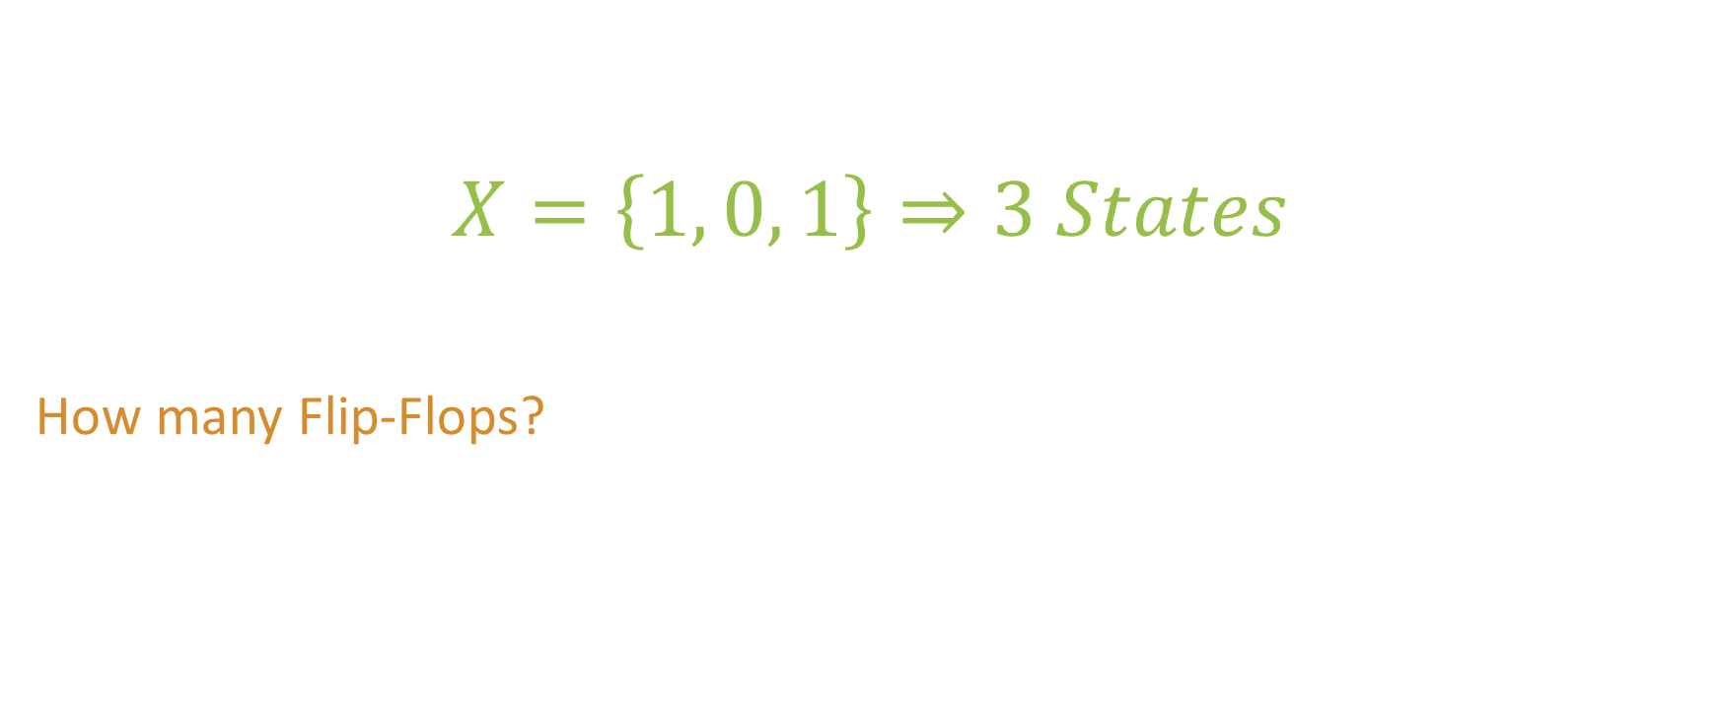
Design Specification
We will need 1 state for every number in the sequence.
$$X=\left\{1, 0, 1\right\}⇒3 States$$
How many Flip-Flops?

Slide 24
Design Specification
To represent 3 states, we need 2 flip-flops.
There will be 1 unused state.
Do we need a Mealy or Moore machine.

Slide 25
Design Specification
We could design a Mealy or a Moore Machine.
There are pros and cons to both.
We will design a Mealy Machine.

Slide 26
Design Specification
Mealy Machine
1-bit input X
1-bit output Z = 1 if X = {1, 0, 1}
3 States, 2 Flip-Flops (A, B)

Slide 27

What questions do you have?

Slide 28
State Graph
Design a Sequence Detector
Modern Digital System Design

Slide 29



$$S_{0}$$
$$S_{2}$$
$$S_{1}$$

Slide 30

0$/0$
$$S_{0}$$
$$S_{2}$$
$$S_{1}$$

Slide 31

0$/0$
$$S_{0}$$
1$/0$
$$S_{2}$$
$$S_{1}$$

Slide 32

0$/0$
$$S_{0}$$
1$/0$
$$S_{2}$$
$$S_{1}$$
0$/0$

Slide 33

0$/0$
$$S_{0}$$
1$/0$
$$S_{2}$$
$$S_{1}$$
1$/0$
0$/0$

Slide 34

0$/0$
$$S_{0}$$
1$/0$
0$/0$
$$S_{2}$$
$$S_{1}$$
1$/0$
0$/0$

Slide 35

0$/0$
$$S_{0}$$
1$/0$
0$/0$
1$/1$
$$S_{2}$$
$$S_{1}$$
1$/0$
0$/0$

Slide 36
What questions do you have?

Slide 37
State Table
Design a Sequence Detector
Modern Digital System Design

Slide 38
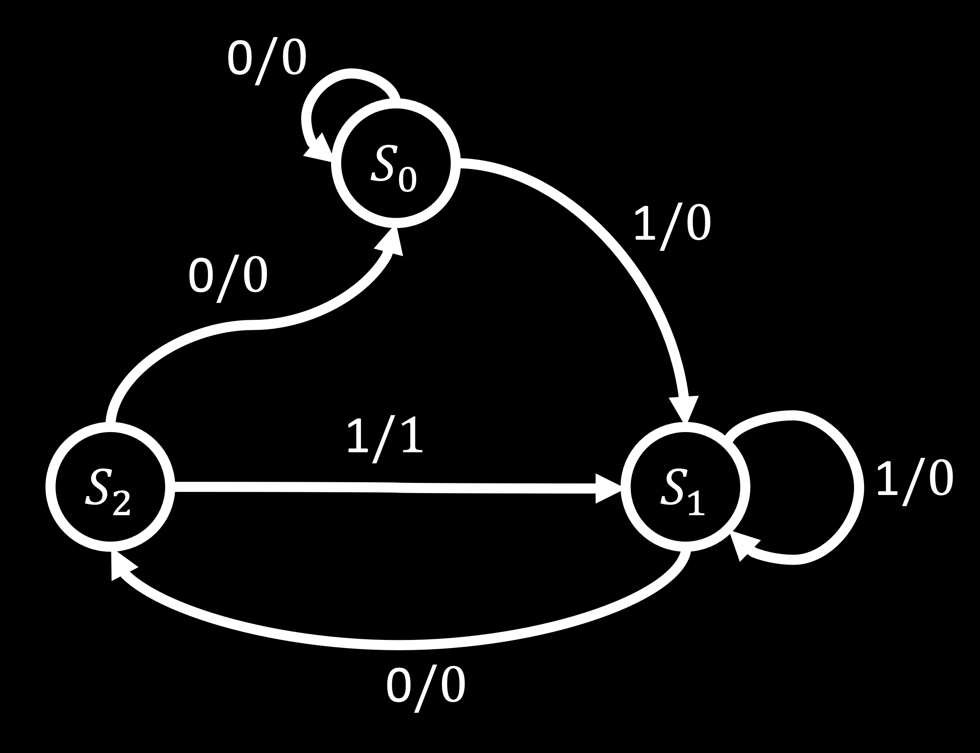
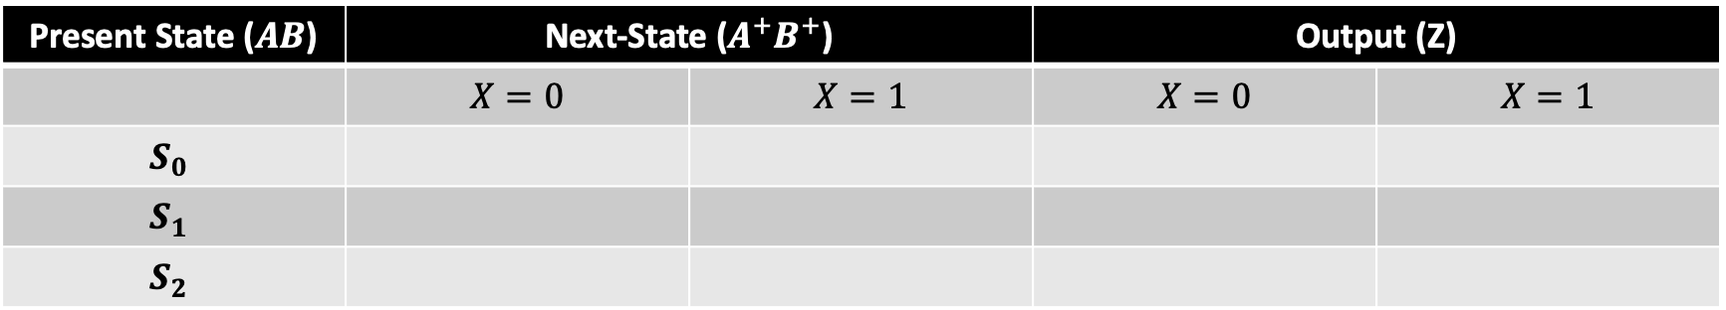
State Table
Present State ($AB$) | Next-State ($A^{+}B^{+}$) |  | Output (Z)
 | $$X=0$$ | $$X=1$$ | $$X=0$$ | $$X=1$$
$$S_{0}$$
$$S_{1}$$
$$S_{2}$$

Slide 39
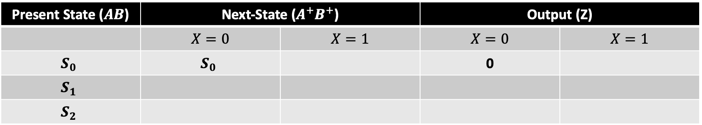
State Table
Present State ($AB$) | Next-State ($A^{+}B^{+}$) |  | Output (Z)
 | $$X=0$$ | $$X=1$$ | $$X=0$$ | $$X=1$$
$$S_{0}$$ | $$S_{0}$$ |  | 0
$$S_{1}$$
$$S_{2}$$

Slide 40
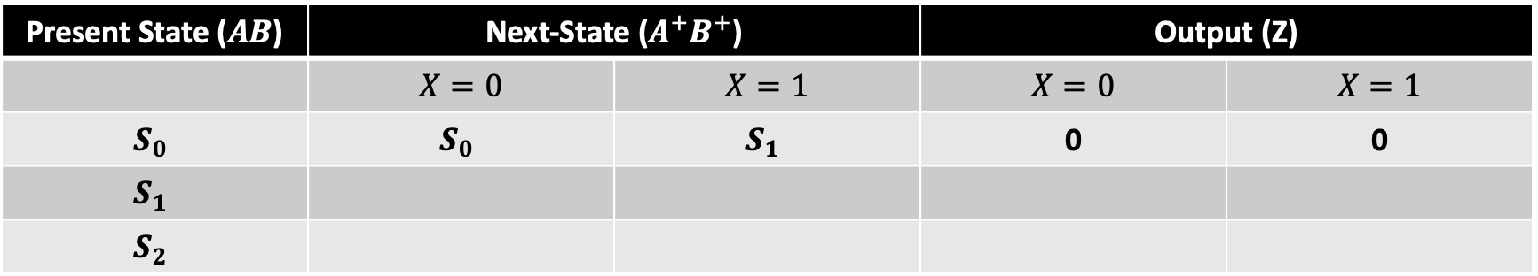
State Table
Present State ($AB$) | Next-State ($A^{+}B^{+}$) |  | Output (Z)
 | $$X=0$$ | $$X=1$$ | $$X=0$$ | $$X=1$$
$$S_{0}$$ | $$S_{0}$$ | $$S_{1}$$ | 0 | 0
$$S_{1}$$
$$S_{2}$$

Slide 41
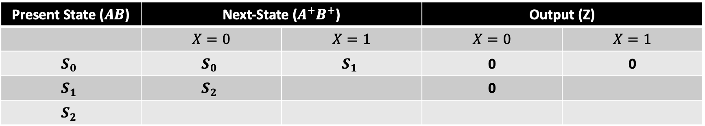
State Table
Present State ($AB$) | Next-State ($A^{+}B^{+}$) |  | Output (Z)
 | $$X=0$$ | $$X=1$$ | $$X=0$$ | $$X=1$$
$$S_{0}$$ | $$S_{0}$$ | $$S_{1}$$ | 0 | 0
$$S_{1}$$ | $$S_{2}$$ |  | 0
$$S_{2}$$

Slide 42
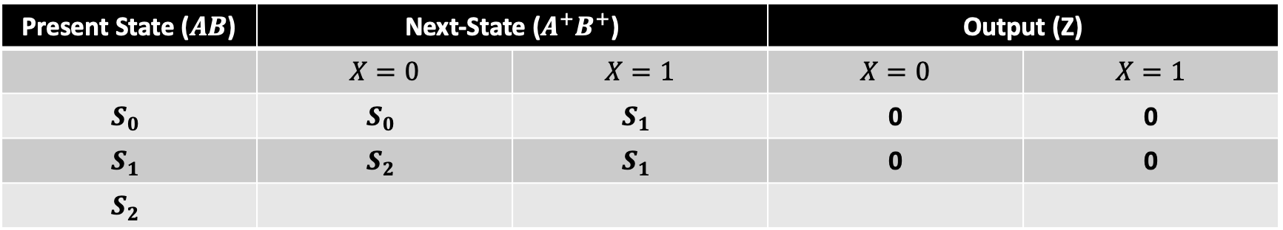
State Table
Present State ($AB$) | Next-State ($A^{+}B^{+}$) |  | Output (Z)
 | $$X=0$$ | $$X=1$$ | $$X=0$$ | $$X=1$$
$$S_{0}$$ | $$S_{0}$$ | $$S_{1}$$ | 0 | 0
$$S_{1}$$ | $$S_{2}$$ | $$S_{1}$$ | 0 | 0
$$S_{2}$$

Slide 43
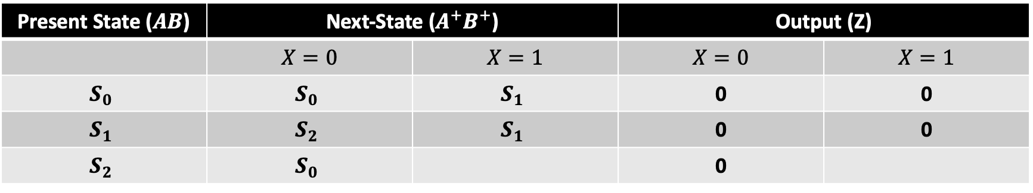
State Table
Present State ($AB$) | Next-State ($A^{+}B^{+}$) |  | Output (Z)
 | $$X=0$$ | $$X=1$$ | $$X=0$$ | $$X=1$$
$$S_{0}$$ | $$S_{0}$$ | $$S_{1}$$ | 0 | 0
$$S_{1}$$ | $$S_{2}$$ | $$S_{1}$$ | 0 | 0
$$S_{2}$$ | $$S_{0}$$ |  | 0

Slide 44
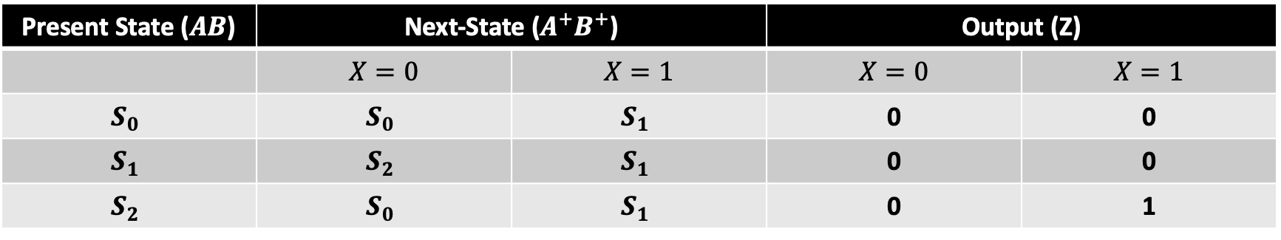
State Table
Present State ($AB$) | Next-State ($A^{+}B^{+}$) |  | Output (Z)
 | $$X=0$$ | $$X=1$$ | $$X=0$$ | $$X=1$$
$$S_{0}$$ | $$S_{0}$$ | $$S_{1}$$ | 0 | 0
$$S_{1}$$ | $$S_{2}$$ | $$S_{1}$$ | 0 | 0
$$S_{2}$$ | $$S_{0}$$ | $$S_{1}$$ | 0 | 1

Slide 45
What questions do you have?

Slide 46
Transition Table
Design a Sequence Detector
Modern Digital System Design

Slide 47




Transition Table
We need to apply some binary values to our states.
Starting with $S_{0}$, count up using Gray Code
$$S_{0}=00$$
$$S_{1}=01$$
$$S_{2}=11$$

Slide 48
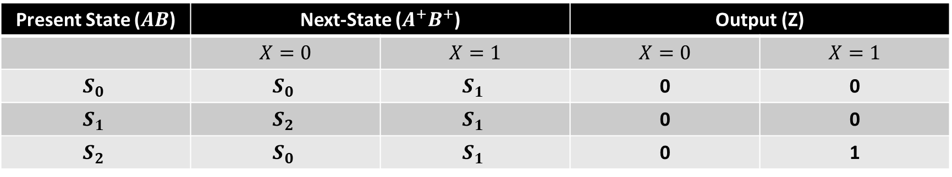
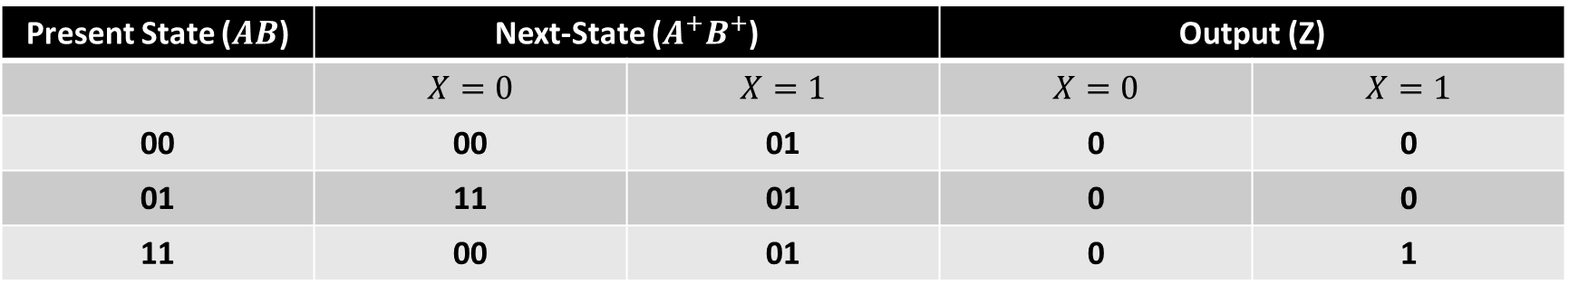
Transition Table
Present State ($AB$) | Next-State ($A^{+}B^{+}$) |  | Output (Z)
 | $$X=0$$ | $$X=1$$ | $$X=0$$ | $$X=1$$
00 | 00 | 01 | 0 | 0
01 | 11 | 01 | 0 | 0
11 | 00 | 01 | 0 | 1
State Table
Present State ($AB$) | Next-State ($A^{+}B^{+}$) |  | Output (Z)
 | $$X=0$$ | $$X=1$$ | $$X=0$$ | $$X=1$$
$$S_{0}$$ | $$S_{0}$$ | $$S_{1}$$ | 0 | 0
$$S_{1}$$ | $$S_{2}$$ | $$S_{1}$$ | 0 | 0
$$S_{2}$$ | $$S_{0}$$ | $$S_{1}$$ | 0 | 1

Slide 49
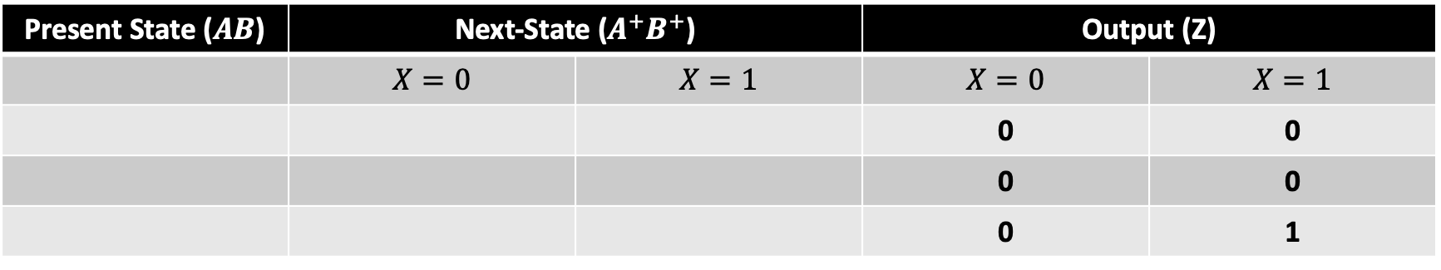
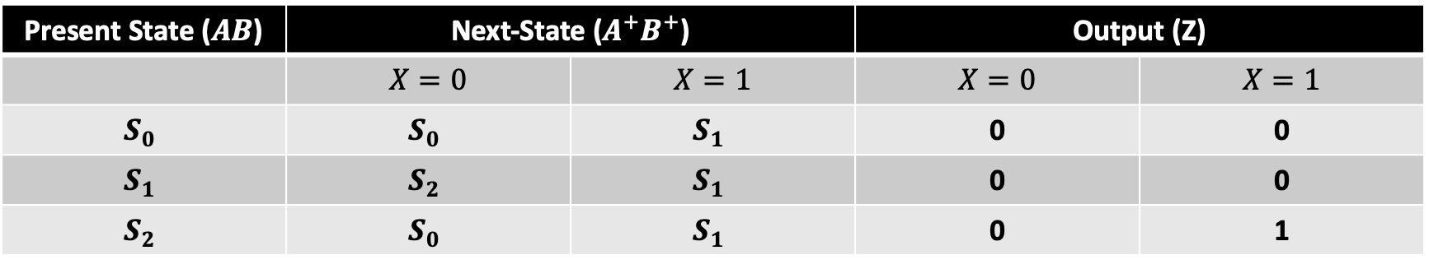
State Table
Present State ($AB$) | Next-State ($A^{+}B^{+}$) |  | Output (Z)
 | $$X=0$$ | $$X=1$$ | $$X=0$$ | $$X=1$$
$$S_{0}$$ | $$S_{0}$$ | $$S_{1}$$ | 0 | 0
$$S_{1}$$ | $$S_{2}$$ | $$S_{1}$$ | 0 | 0
$$S_{2}$$ | $$S_{0}$$ | $$S_{1}$$ | 0 | 1
Transition Table
Present State ($AB$) | Next-State ($A^{+}B^{+}$) |  | Output (Z)
 | $$X=0$$ | $$X=1$$ | $$X=0$$ | $$X=1$$
 |  |  | 0 | 0
 |  |  | 0 | 0
 |  |  | 0 | 1

Slide 50
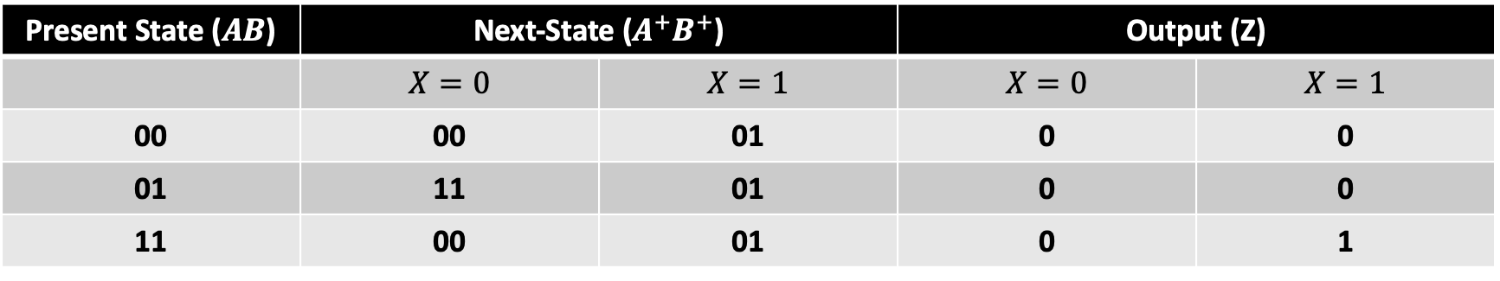
State Table
Present State ($AB$) | Next-State ($A^{+}B^{+}$) |  | Output (Z)
 | $$X=0$$ | $$X=1$$ | $$X=0$$ | $$X=1$$
$$S_{0}$$ | $$S_{0}$$ | $$S_{1}$$ | 0 | 0
$$S_{1}$$ | $$S_{2}$$ | $$S_{1}$$ | 0 | 0
$$S_{2}$$ | $$S_{0}$$ | $$S_{1}$$ | 0 | 1
Transition Table
Present State ($AB$) | Next-State ($A^{+}B^{+}$) |  | Output (Z)
 | $$X=0$$ | $$X=1$$ | $$X=0$$ | $$X=1$$
00 | 00 | 01 | 0 | 0
01 | 11 | 01 | 0 | 0
11 | 00 | 01 | 0 | 1

Slide 51
What questions do you have?

Slide 52
Next-State and Output Equations
Design a Sequence Detector
Modern Digital System Design

Slide 53
Next-State and Output Equations
Plot the transition table on a K-Map.
Use the K-Map to get optimized Boolean functions

Slide 54
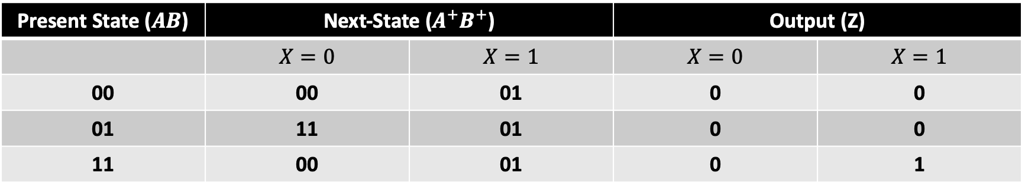
Z
AB
A’
A
X
X’
0
0
0
X
0
1
3
2
X
0
0
1
X
4
5
7
6
B’
B
B’
Transition Table
Present State ($AB$) | Next-State ($A^{+}B^{+}$) |  | Output (Z)
 | $$X=0$$ | $$X=1$$ | $$X=0$$ | $$X=1$$
00 | 00 | 01 | 0 | 0
01 | 11 | 01 | 0 | 0
11 | 00 | 01 | 0 | 1

Slide 55

Z
AB
A’
A
X
X’
0
0
0
X
0
1
3
2
X
0
0
1
X
4
5
7
6
B’
B
B’
$$Z\left(X, A, B\right)=AX$$

Slide 56
A+
AB
A’
A
X
X’
0
1
0
X
0
1
3
2
X
0
0
0
X
4
5
7
6
B’
B
B’
Transition Table
Present State ($AB$) | Next-State ($A^{+}B^{+}$) |  | Output (Z)
 | $$X=0$$ | $$X=1$$ | $$X=0$$ | $$X=1$$
00 | 00 | 01 | 0 | 0
01 | 11 | 01 | 0 | 0
11 | 00 | 01 | 0 | 1

Slide 57

A+
AB
A’
A
X
X’
0
1
0
X
0
1
3
2
X
0
0
0
X
4
5
7
6
B’
B
B’
$$A^{+}\left(X, A, B\right)=X^{′}A^{′}B$$

Slide 58
B+
AB
A’
A
X
X’
0
1
0
X
0
1
3
2
X
1
1
1
X
4
5
7
6
B’
B
B’
Transition Table
Present State ($AB$) | Next-State ($A^{+}B^{+}$) |  | Output (Z)
 | $$X=0$$ | $$X=1$$ | $$X=0$$ | $$X=1$$
00 | 00 | 01 | 0 | 0
01 | 11 | 01 | 0 | 0
11 | 00 | 01 | 0 | 1

Slide 59

B+
AB
A’
A
X
X’
0
1
0
X
0
1
3
2
X
1
1
1
X
4
5
7
6
B’
B
B’
$$B^{+}\left(X, A, B\right)=X+$$

Slide 60

B+
AB
A’
A
X
X’
0
1
0
X
0
1
3
2
X
1
1
1
X
4
5
7
6
B’
B
B’
$$B^{+}\left(X, A, B\right)=X+A^{′}B$$

Slide 61

What questions do you have?

Slide 62
Verilog Implementation
Design a Sequence Detector
Modern Digital System Design

Slide 63

Next-State and Output Equations
We are now ready to implement our design in Verilog
Mealy circuit design pattern
$Z=AX$
$A^{+}=X^{′}A^{′}B$
$B^{+}=X+A^{′}B$~

Slide 64
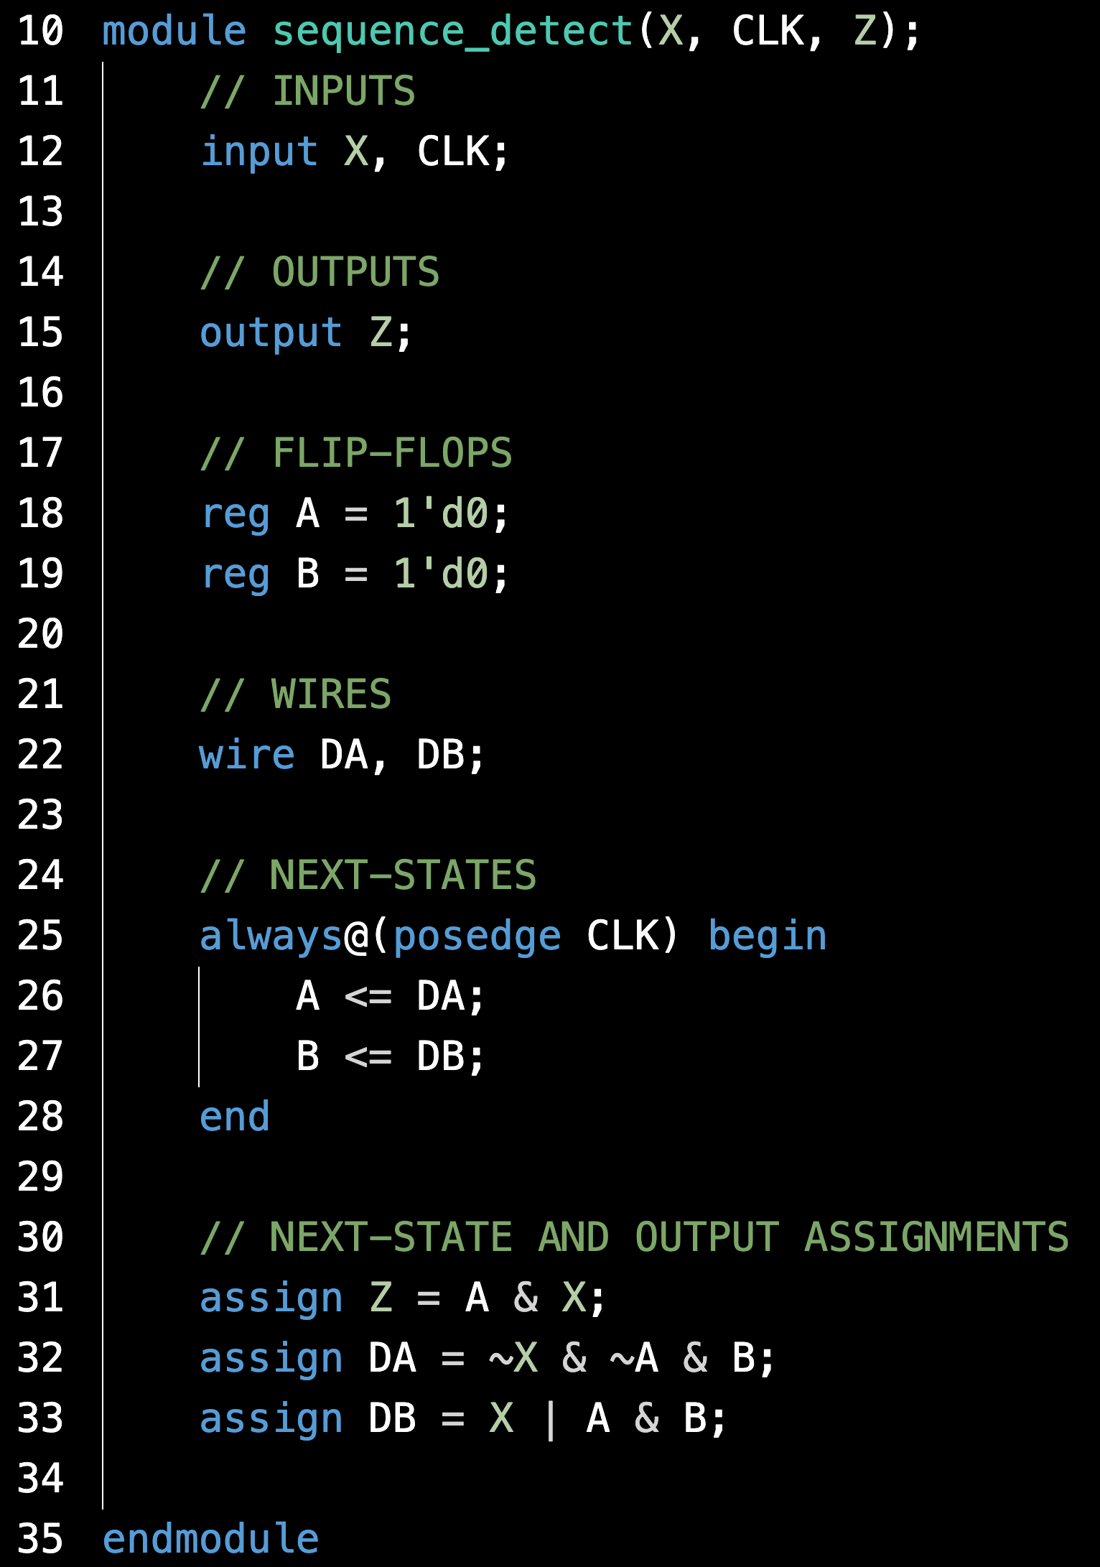

Slide 65
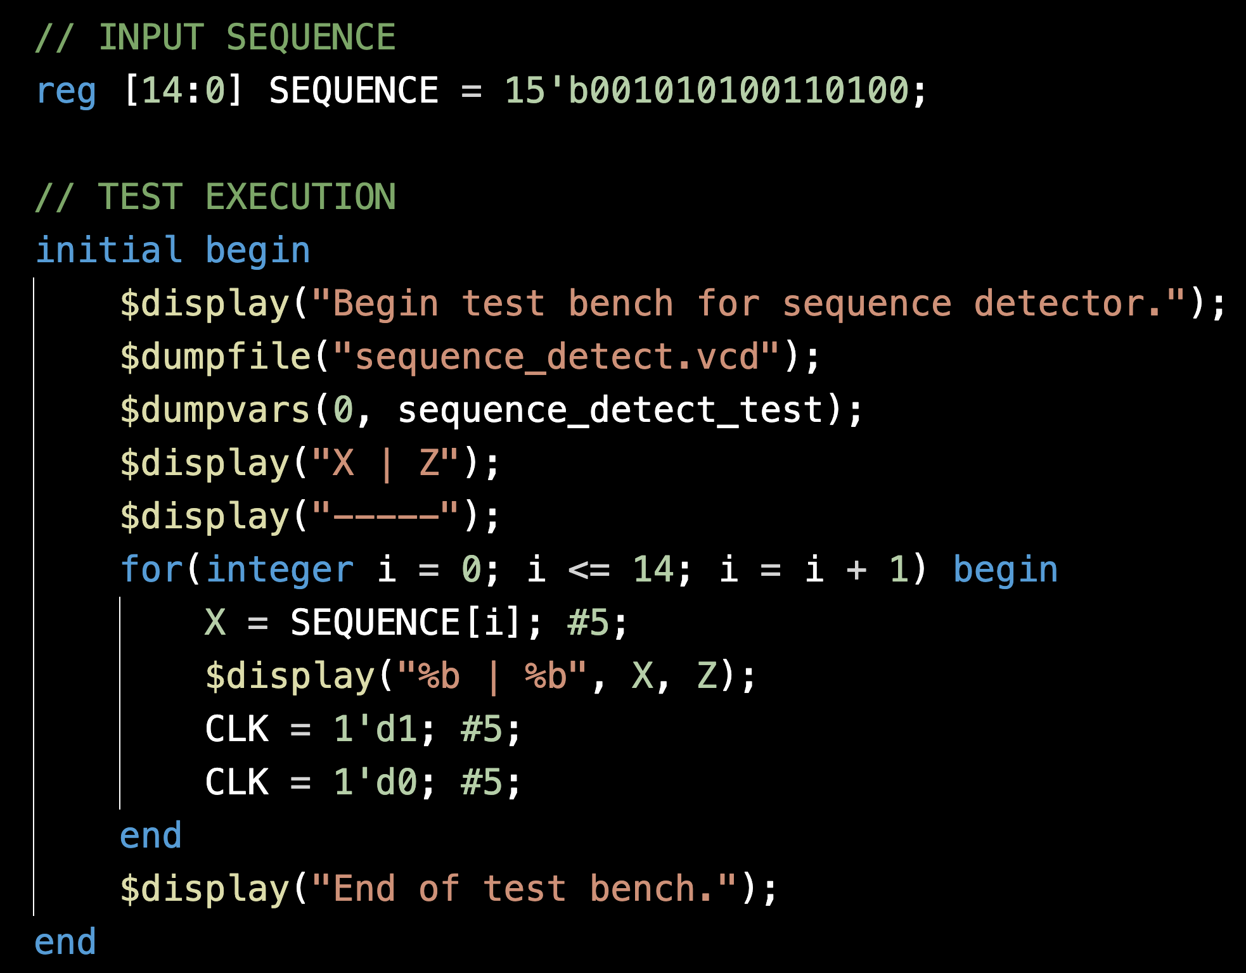

Slide 66
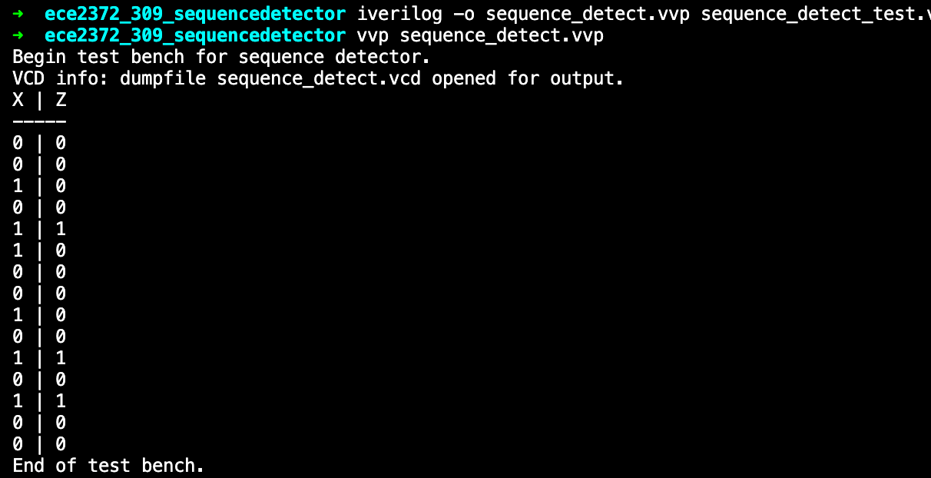

Slide 67
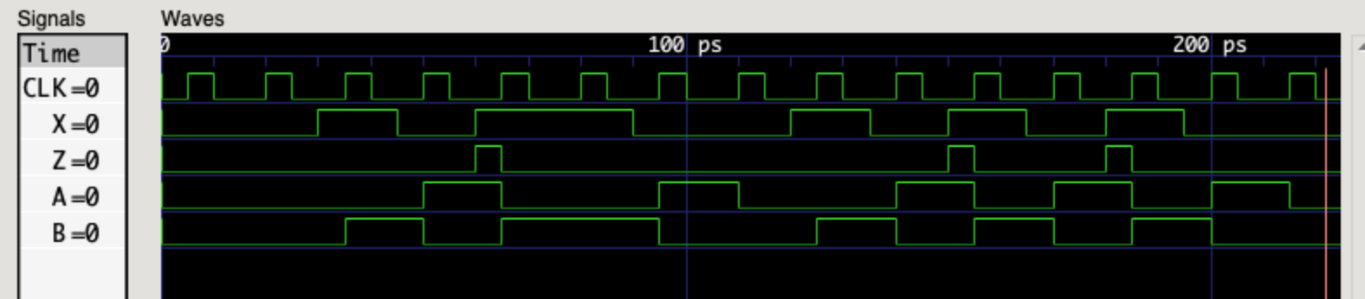

Slide 68
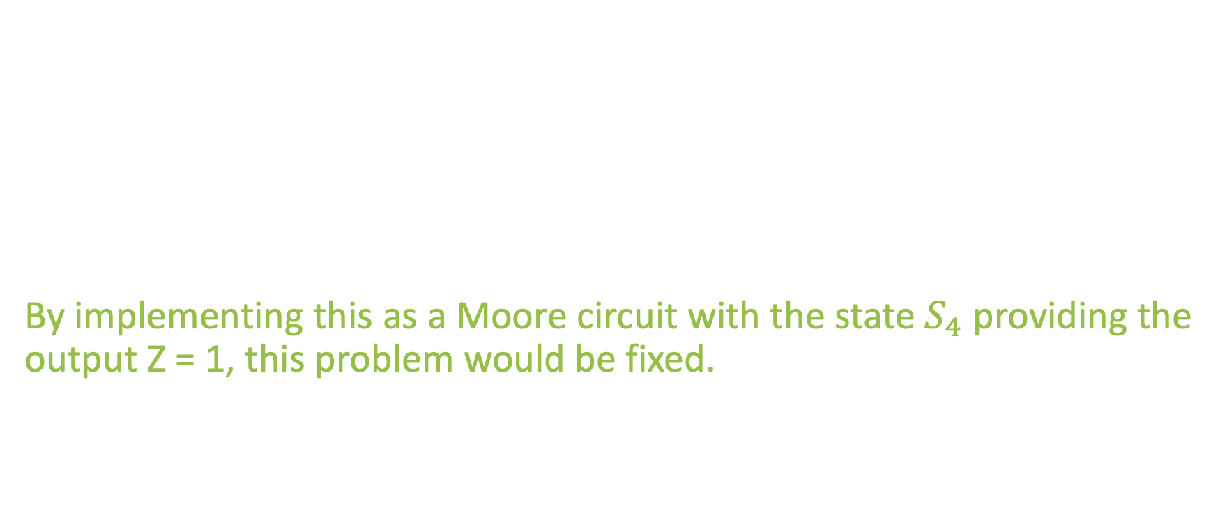
Final Thoughts
By implementing this design with a Mealy machine, the output Z is asynchronous.
The Z = 1 output is reset to zero on the very next rising edge.
By implementing this as a Moore circuit with the state $S_{4}$ providing the output Z = 1, this problem would be fixed.

Slide 69
What questions do you have?

Slide 70
Lecture Recap
Design Specification
State Graph
State Table
Transition Table
Next-State and Output Equations
Verilog Implementation

Slide 71
What questions do you have?

Slide 72
Design a Sequence Detector
ECE 2372 | Modern Digital System Design | Texas Tech University

